Slide 1
Statistical Rejection Sampling Improves Preference Optimization
Tiaqi Liu,Yao Zhao et al.
https://arxiv.org/pdf/2309.06657
Group 5
Shivank Garg, Abhi, Aakash K Singh, Abhishek Baghel

Slide 2
Introduction
LLMS: -
Perform variety of NLP tasks by learning patterns and structures of the human language
Trained on large unlabeled corpora of text
Supervised fine-tuned on various tasks
But these models have a drawback
They are not aligned with human preferences
Notes:
Diverse tasks can be performed using LLMs, DL, transformers , The LLM models may generate irrelevant inappropriate output that we will see

Slide 3
Why is there a need to align?
(QUERY)
Is pineapple on pizza a crime?
Pretraining
Pretrained
LLM
(RESPONSE)
This is one of the questions that will be answered at the pizza party

Slide 4
Why is there a need to align?
(QUERY)
Is pineapple on pizza a crime?
Pretraining
Supervised
fine-tuning
SFT LLM
(RESPONSE)
Yes, adding pineapple on pizza is a criminal offence

Slide 5
Why is there a need to align?
(QUERY)
Is pineapple on pizza a crime?
Pretraining
Supervised
fine-tuning
Aligned
LLM
Aligning the model
(RESPONSE)
No, it is not a crime to add pineapple on pizza. It is a matter of personal preference and taste

Slide 6
This paper deals with the various methods used for aligning the LLM model to human preferences
Introduces a novel method, RSO, which addresses the limitations of the previous approaches
Proposes a scalable and flexible method to train models on human preferences with an emphasis on the reward model.
Introduces an effective rejection sampling method to generate preference pairs from the optimal policy for better training results.
Notes:
More accurately sampling preference pairs from optimal policy thru rejection sampling

Slide 7
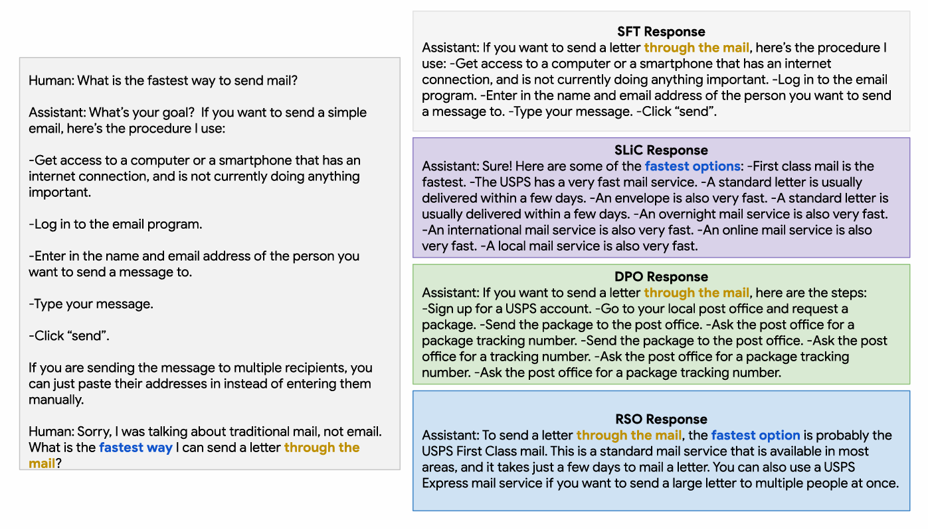
Notes:
Trained on AnthropicHH dataset

Slide 8
Background and Relevant Work
Using “Human Feedback” and Behaviour to drive the behaviour of a generative model.
Especially useful when :
You can’t create a good loss function (e.g., how do you calculate a metric to measure if the model’s output was funny?)
You want to train with production data, but you can’t easily label your production data (e.g., how do you get labeled production data from ChatGPT? Someone needs to write the correct answer that ChatGPT should have answered)

Slide 9
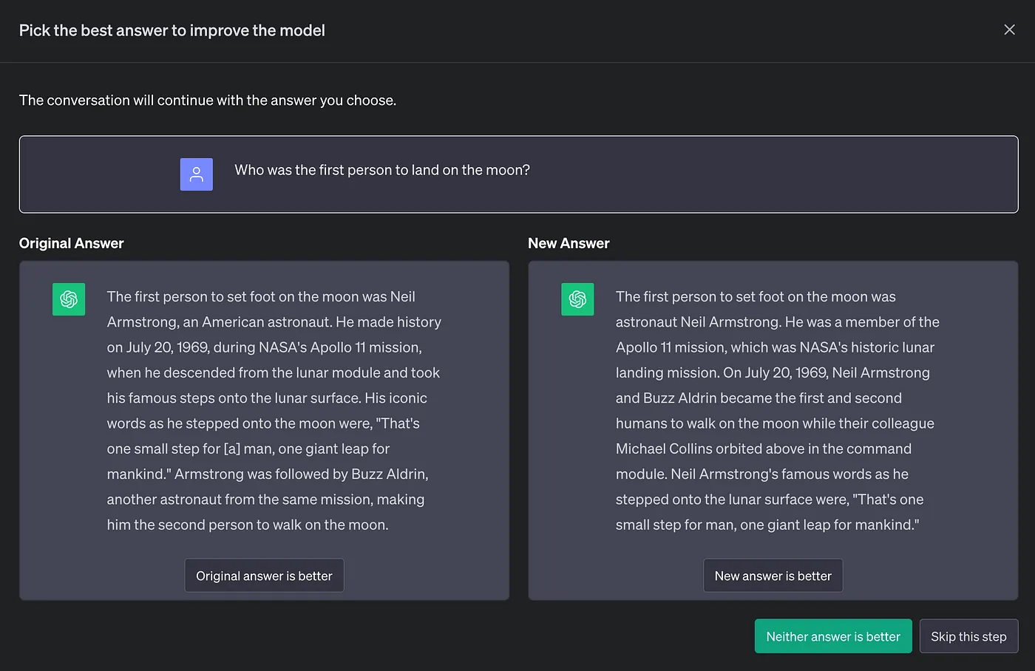
Preference Data Collection
Preference data collection in ChatGPT :

Slide 10
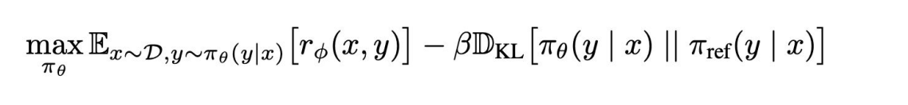
Dataset
In these algorithms, we need a dataset of triplets.
(prompts,chosen answer,rejected answer)
Training Objective:
π: LLM policy
πθ : Base LLM
x: prompt
y: completion

Slide 11
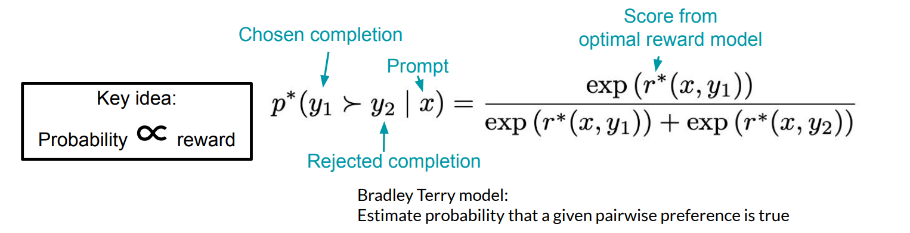
Reward Modelling
Can we just use supervised learning on scores?
● Assigning a scalar reward of how good a response is did not work
● Pairwise preferences are easy to collect and worked!

Slide 12
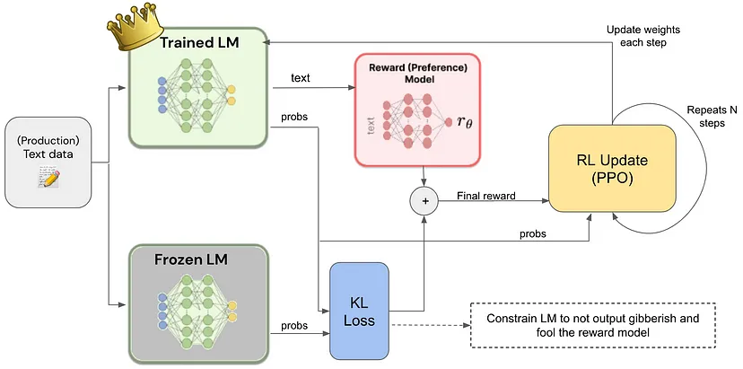
Objective Optimization (RLHF)
Since, the reward values are discrete values(binary 0/1) or absolute rewards eg between (1-100) we need to make the loss function differentiable.
That's where we use Reinforcement Learning !

Slide 13
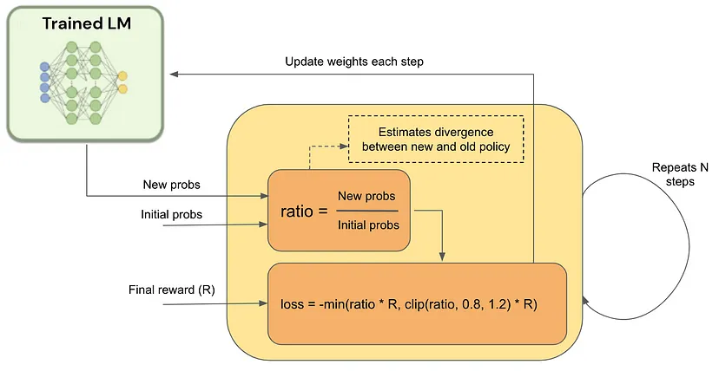
RLHF Training Loop
https://proceedings.neurips.cc/paper/2020/file/1f89885d556929e98d3ef9b86448f951-Paper.pdf

Slide 14
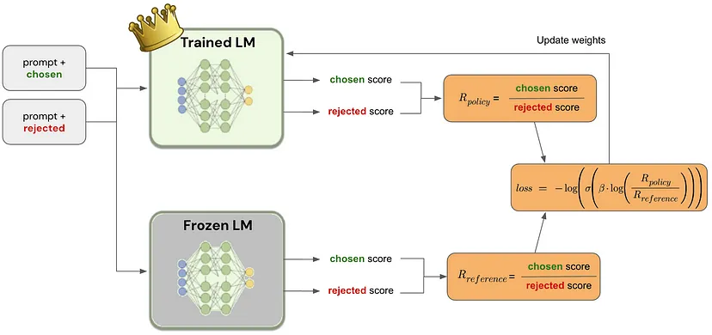
Objective Optimization (DPO)
What if we directly apply gradiant ascent on the training objective?
Answer : Use DPO(Not really RL).The model is directly optimized using human preferences.
https://arxiv.org/pdf/2305.18290

Slide 15
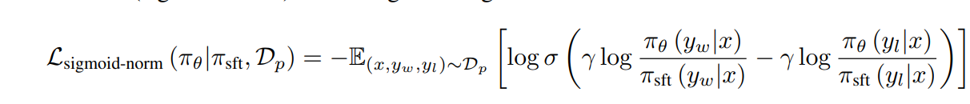

Sequence Likelihood Calibration
DPO Objective Function : Uses sigmoid loss on normalized likelihood (sigmoid-norm) to fit a logistic regression.
SLiC Objective : We use a hinge calibration loss.
The difference between SLiC and DPO is similar to that between SVM and Logistic regression
https://arxiv.org/pdf/2305.10425

Slide 16


Training Models with Preference Data
Goal : Align the model's behavior with human preferences.
Ideal Dataset :
Real-World Dataset :
Challenges :
Inconsistent Response
Unknown Policy Source
Suboptimal Training

Slide 17
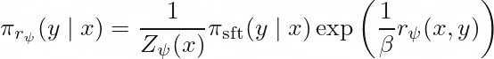

Approaches to handle Real World Dataset
Direct Approach :
Directly fits the policy on D_{hf}, without additional filtering or ranking.
SFT-Sample-Rank :
Uses SFT policy to sample responses for each prompt, and labels them based on reward model.
RSO-Sample-Rank :
Use 𝜋𝑟𝜓(𝑦∣𝑥) to sample response pairs labelled by reward model given prompts from the SFT training set.

Slide 18


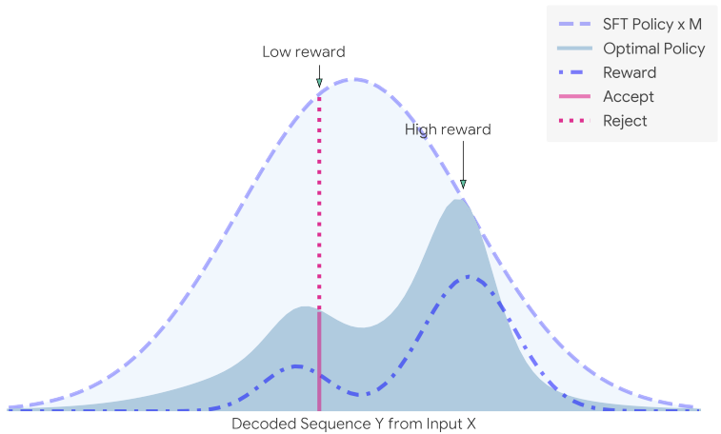
Statistical Rejection Sampling Algorithm
1. Start with empty Y = {}.
2. Generate y ∼ πsft(y|x) that is not in Y and u ∼ U[0, 1].
3. Let
If
4. Repeat step 2 and 3 until we get enough Y.

Slide 19
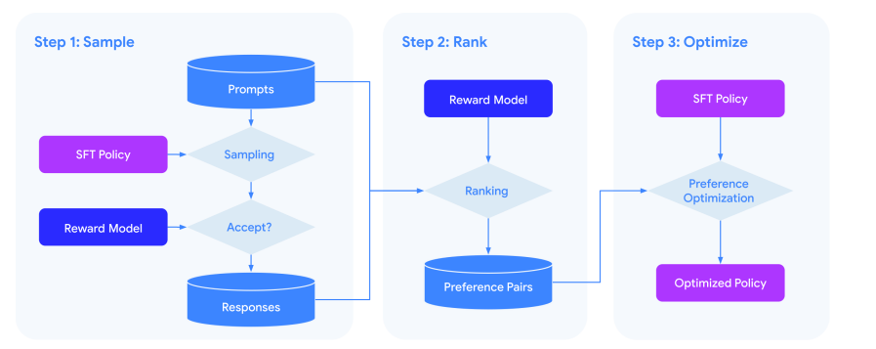
Workflow of RSO

Slide 20
Experiments

Slide 21
Experimental Setup
To evaluate the effectiveness of the proposed Statistical Rejection Sampling Optimization (RSO) approach compared to SLiC and DPO, and other baselines.
Datasets used:
1. Reddit TL;DR Summarization
2. AnthropicHH Dialogue
Notes:
T5-large (770M) SFT policy and a T5-XXL (11B) pairwise reward ranking model
To construct preference pairs, we first sample 64 response candidates from the SFT policy using temperature sampling with temperature = 0.7 and top k = 40. Then we sub-sample 8 samples.
batch size 32 and learning rate 1e-5 with Adafactor optimizer
checkpoint with the highest reward-ranking model win rate against the SFT target.

Slide 22
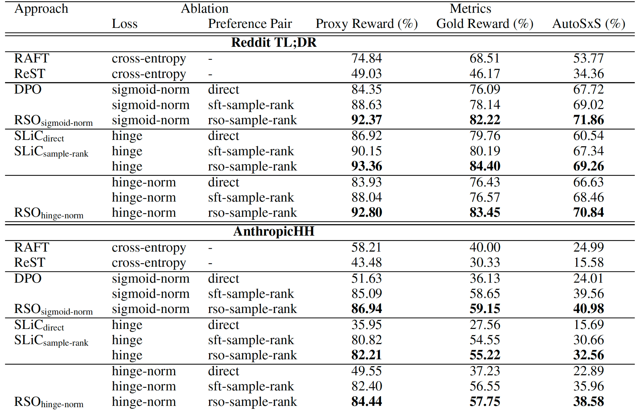
Performance comparison
https://arxiv.org/pdf/2308.08998 https://arxiv.org/pdf/2304.06767
Notes:
compared by nine settings combining different loss functions and preference data distributions. eval metrics
_
Proxy Reward Model computes win rate of generated response against SFT target on the trained T5-XXL pairwise reward-ranking model.
calculates the win rate of generated responses against a baseline by comparing their predicted scores. The higher the win rate, the better the model's alignment with the reward model.
Gold Reward Model is similar to the Proxy Reward Model but is typically a more accurate and robust model trained specifically to serve as a standard for evaluating responses.
trained with high-quality data or with a more complex architecture.
AutoSxS uses PaLM 2-L few-shot in-context learning.
Human Evaluation asks human raters to assign a quality score on each response and determine the best one among three systems

Slide 23
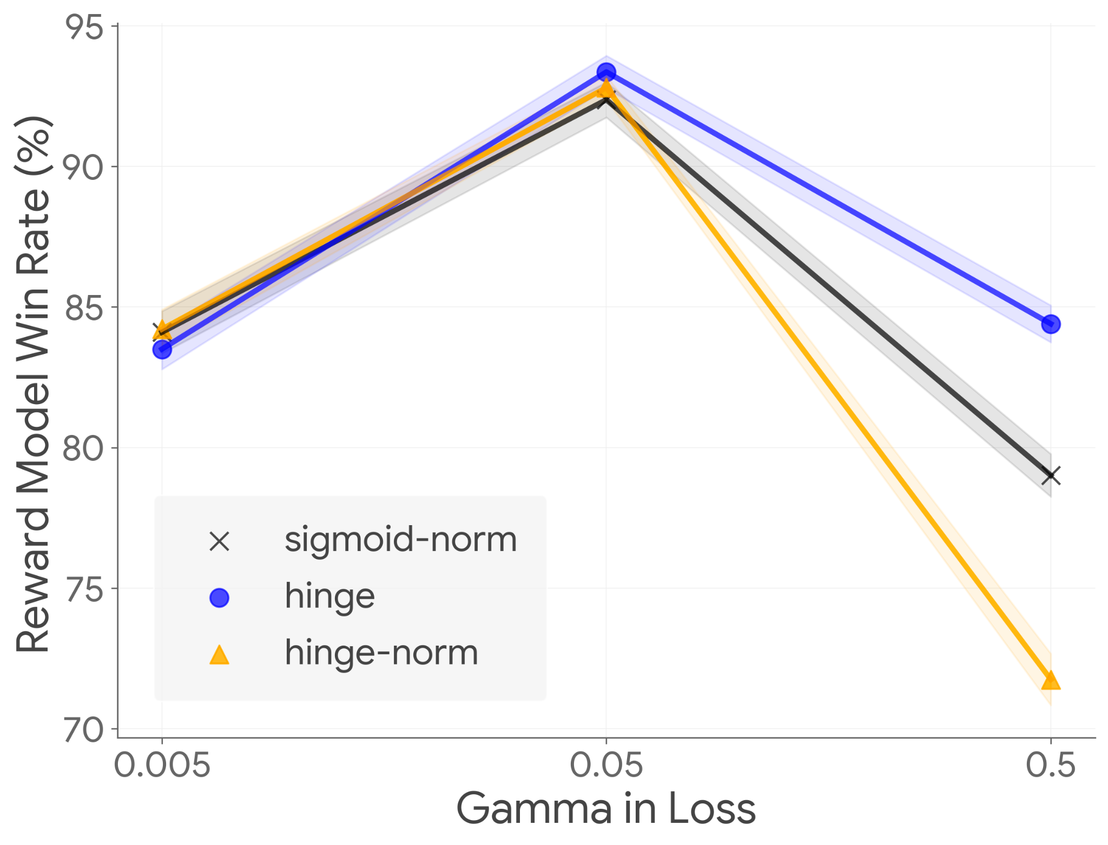
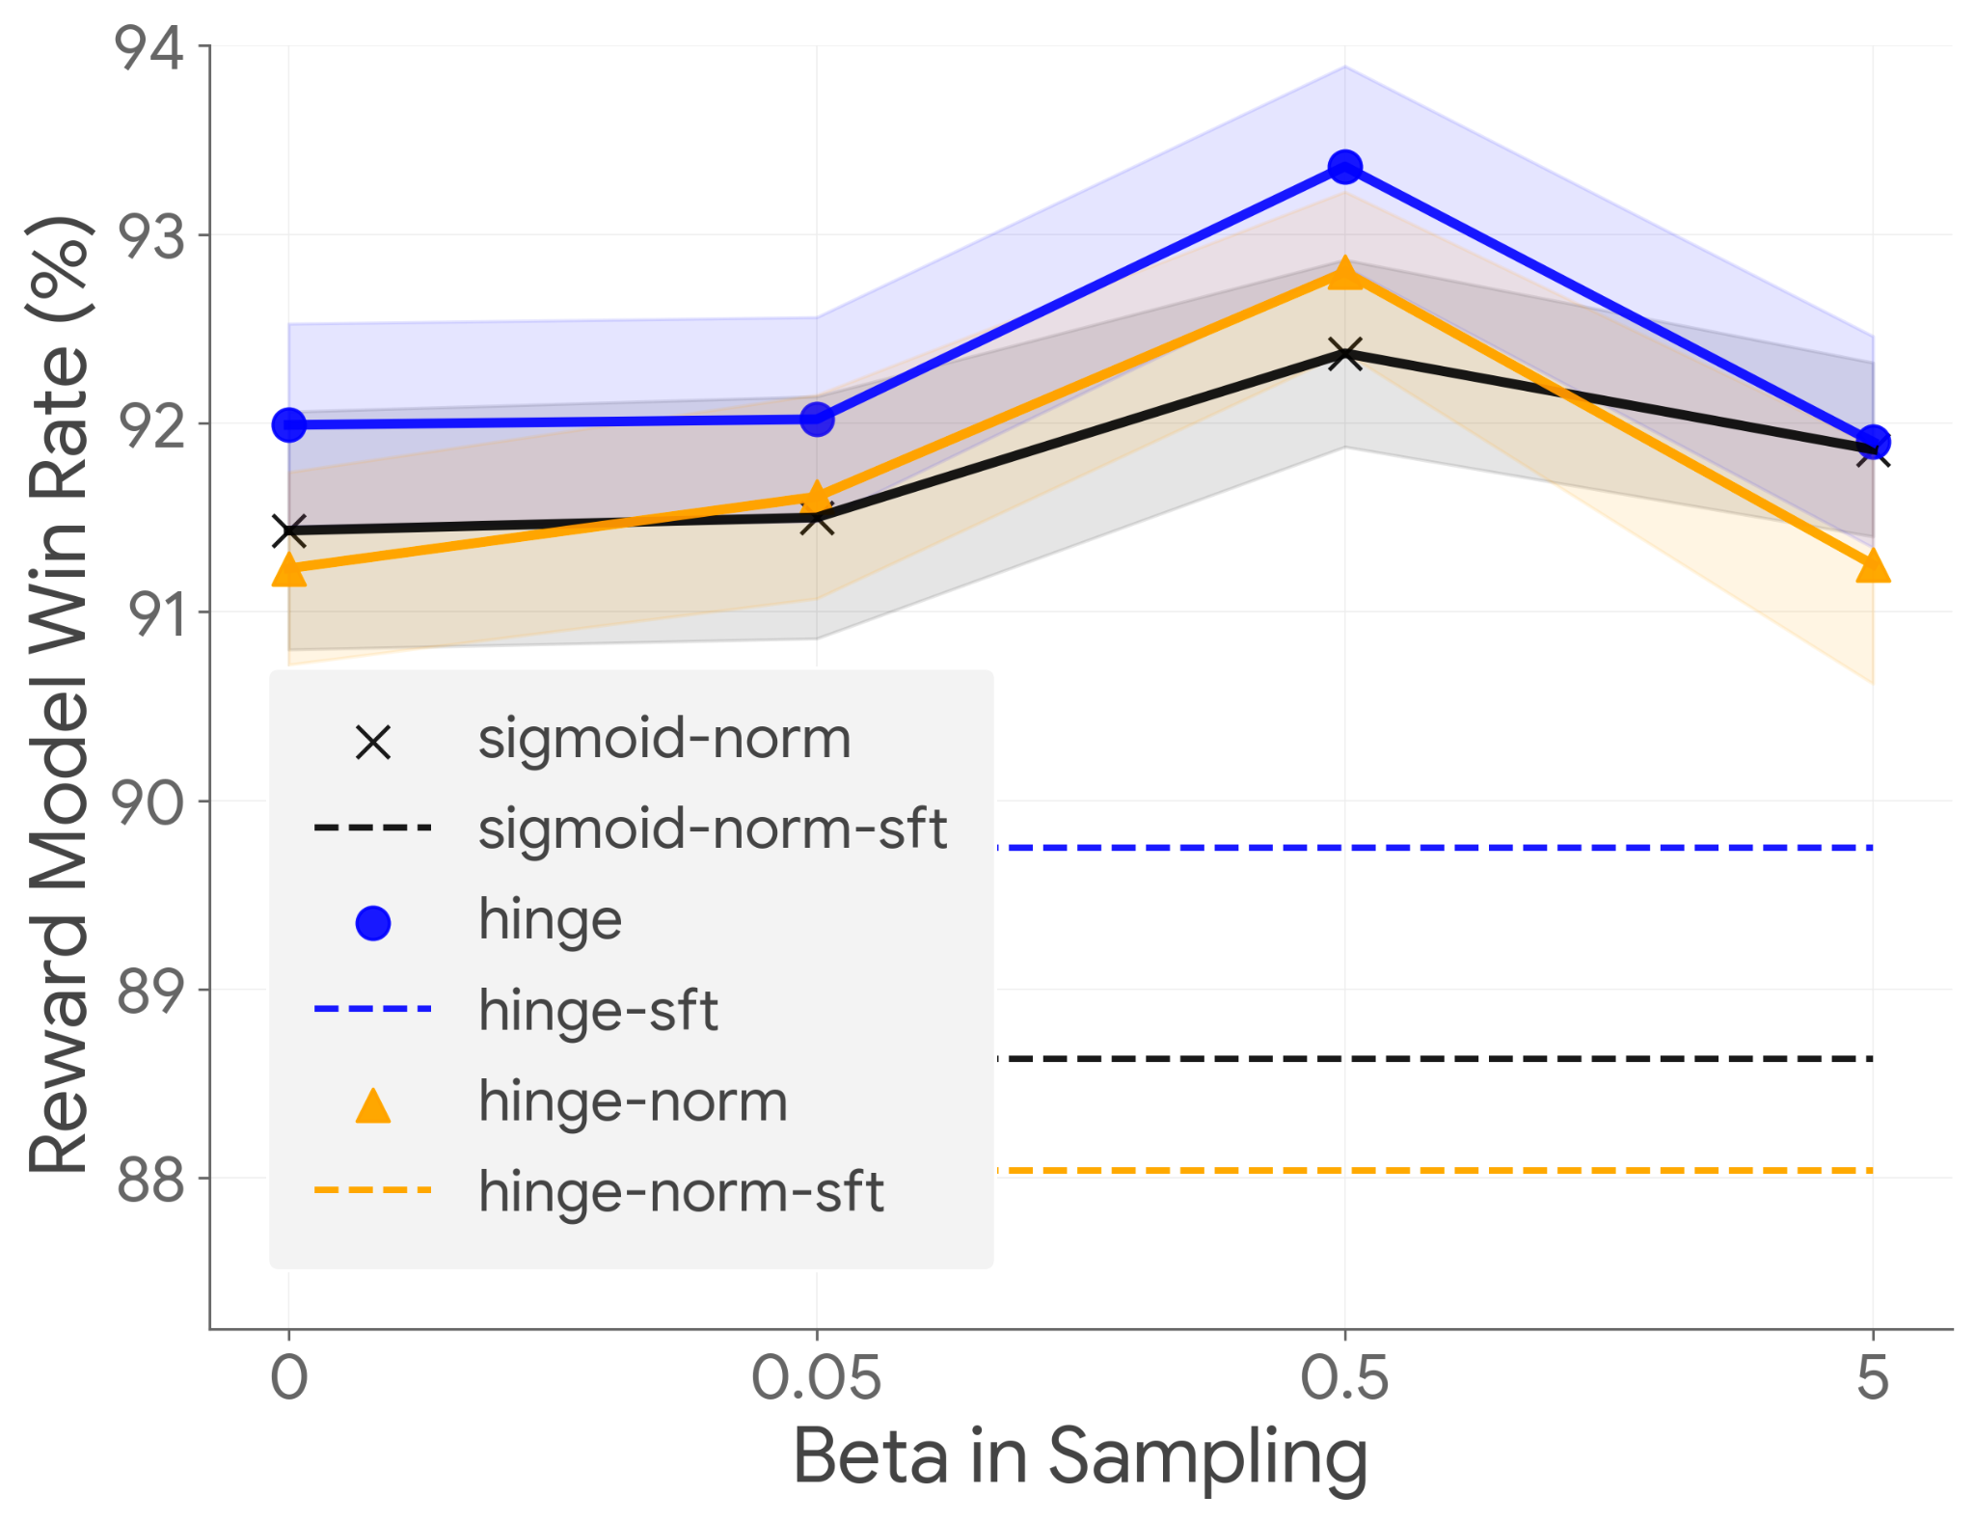
Ablation Studies
Hyperparameters:
γ in Loss Function
β in Rejection Sampling
Optimal values: β = 0.5, γ = 0.05 for RSO.
Notes:
1. γ in Loss Function:
- Higher values penalize misclassification more, while lower values reduce regularization (allowing for mislassifications).
controls the scaling of the logits before applying the loss function, effectively determining the sharpness of the decision boundary.
A larger value means that the model is more confident in classifying preferences, leading to a steeper penalty for misclassified examples.
2. β in Rejection Sampling:
- Controls the balance between exploration and exploitation in the policy optimization process.
- Use a lower beta if you have more confidence in the reward model (and not explore)
A smaller means the model is more aggressive in exploiting high-reward actions, while a larger value indicates a more balanced approach that allows for exploration of different responses.

Slide 24
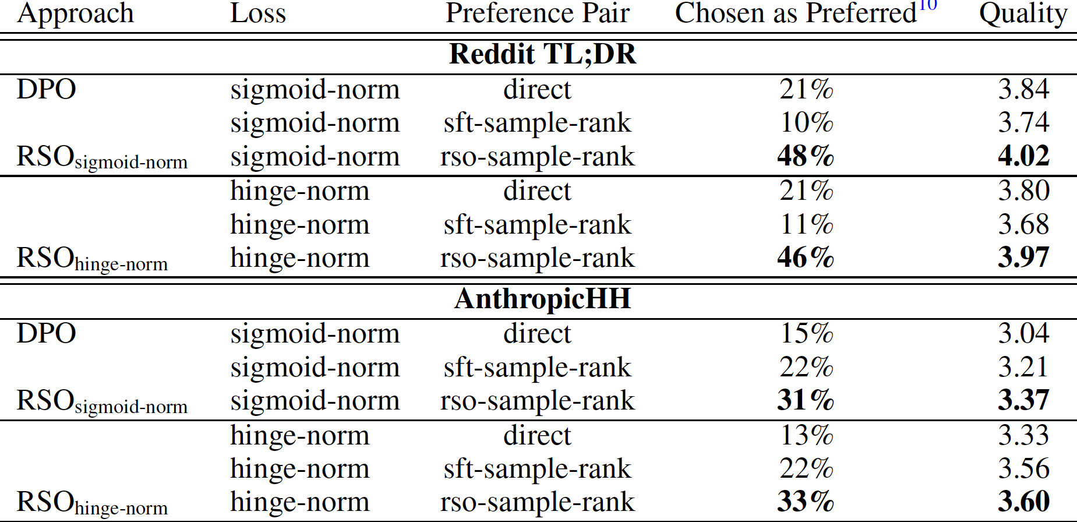
Human Evaluation Results
Human evaluations show that ‘rso-sample-rank’ significantly outperforms ‘direct’ and ‘sft-sample-rank’ in all tasks, with RSO being preferred over DPO by more than 2x.
Notes:
- RSO is consistently rated higher by human evaluators.
- The approach effectively aligns generated outputs with human preferences.
Human Evaluation asks human raters to assign a quality score on each response and determine the best one among three systems

Slide 25
Conclusion
The paper proposes RSO recipe to train large language models from human feedback as an alternative to RLHF.
It presents a novel statistical rejection sampling for better preference pair generation.
RSO presents a scalable and effective framework for learning from human feedback.

Slide 26
Thank You
Notes:
questions

